Slide 1


Cleaning the Data
SIT112 | Intro to Data Science & AI
Lecture Week 5
Dr Fatima ansarizadeh
Lecturer in Applied AI
School of Information Technology, Deakin University
Email: f.ansarizadeh@deakin.edu.au

Slide 2
Objectives
Identify the data problems in a DataFrame by using the info(), unique(), nunique(), and value_counts() methods.
Remove duplicate rows from a DataFrame.
Drop unnecessary rows and columns in a DataFrame.
Rename columns so the names are easier to understand.
Find and fix the missing values in a DataFrame.
Find and fix datetime and numeric columns that are imported as object data types.
Replace the invalid values in a column and convert the column to the right data type.
Find and fix outliers.

Slide 3

Introduction to Data Cleaning

Slide 4
What is Data Cleaning?
The process of identifying and correcting or removing errors, inconsistencies, and inaccuracies from a dataset.
Involves identifying and correcting missing or invalid data, handling duplicates, dealing with outliers, and addressing inconsistencies or errors in the data.

Slide 5
Why Data Cleaning?
Most datasets aren’t clean when you import them. So, to get accurate results, you need to clean them before you analyse and visualise the data.
Data cleaning ensures the data is accurate, complete, and consistent, which in turn helps to ensure that the results of any analysis or modelling based on that data are valid and reliable.
Without proper data cleaning, any insights or conclusions drawn from the data may be flawed or inaccurate.

Slide 6
Data Cleaning Techniques
Data cleaning can involve a variety of techniques, such as standardisation, normalisation, and outlier detection, and may require a combination of manual and automated approaches depending on the nature and complexity of the data.

Slide 7
A General Plan for Cleaning a DataFrame
Identify
Identify the problems
Review whatever documentation is available to help you understand the data.
Examine the data after you import it into a DataFrame.
Plan the cleaning that needs to be done.
Simplify
Simplify the data
Drop duplicate rows.
Drop rows that aren’t needed for the analysis.
Drop columns that aren’t needed for the analysis.
Rename columns so the names are easier to understand.
Fix
Fix data problems
Find and fix missing values.
Fix data type problems like dates or numbers that are imported as strings.
Find and fix outliers.

Slide 8
Before Cleaning …
Be sure that you’ve set the goals for your analysis.
Those goals should guide your actions throughout the cleaning process.
That will help you decide what cleaning needs to be done.
E.g., which rows and which columns are okay to drop.
Be sure that you aren’t dropping rows or columns that will affect the results of your analysis.

Slide 9
Data Cleaning Takes Time …
Data cleaning typically takes as much as 20 to 25 percent of the total time for an analysis.

Slide 10
How to Identify the Problems?

Slide 11
Using Documentation
Documentation of a dataset can be extremely helpful for data cleaning in several ways:
Understanding the Data: Documentation provides information about the origin of the data, its purpose, the methodology used to collect it, and any known limitations. By understanding the data and its context, you can better identify any anomalies, outliers, or errors in the data.
Identifying Missing Values: Documentation can indicate what missing values might mean in a particular column. For instance, in a survey dataset, a missing value might indicate that a respondent didn't answer a question, rather than a true missing value. By understanding the meaning of missing values, you can impute them more accurately.
Handling Outliers: Documentation can indicate what the range of values should be for a particular column. This can help identify any outliers that fall outside of that range and determine whether they are legitimate data points or errors.
Ensuring Consistency: Documentation can help ensure consistency in the data. For instance, it might indicate that a particular column should only contain categorical variables or that numeric values should be recorded to a certain level of precision.
Cross-Checking Data: Documentation can also be used to cross-check data against other sources. For instance, if a dataset contains information about products, documentation might indicate what the expected values for certain columns should be. By cross-checking these values against an external source, such as a company's website, you can identify any discrepancies or errors.

Slide 12
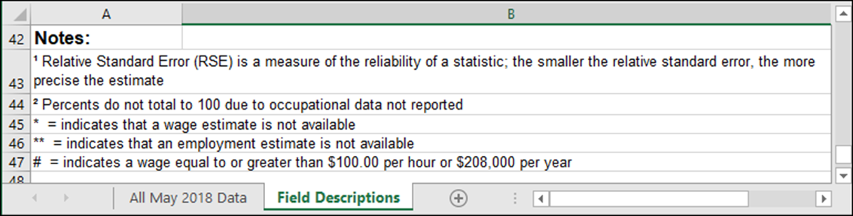
Documentation that Identifies Some Data Problems …

Slide 13
What the info() Method Can Tell You
After you review the documentation for a dataset, you can do your own analysis of potential data problems. To start, you can run the info() method of a DataFrame.
The verbose=True parameter ensures that the method will return all the information rather than an abridged version.
The memory_usage=‘deep’ parameter ensures that the memory usage will be accurate.
The show_counts=True parameter ensures that the method will return the non-null counts for each column.

Slide 14
The Three Parameters of the info() Method
Parameter | Description
verbose=True | Ensures that the method returns info for all of the columns.
memory_usage='deep' | Ensures that the memory usage information is accurate.
show_counts=True | Ensures that the non-null counts for each column will be displayed.

Slide 15
What the info() Method Can Tell You (Cont.)
Depending on how your system is set up, you may not need to code the verbose and show_counts parameters. To see whether you need them, you can run the method with and without those parameters. But as strange as it sounds, you do need to code the memory_usage parameter to get an accurate value for memory usage.
When the info() method displays the information, you look for potential problems. First, you should look for object (or string) columns that look like they contain numbers or dates. For instance, columns with names like “total”, “mean”, and “pct” should probably be numeric data types. And columns with names that include “date” or “time” should probably be datetime objects. Second, you should analyze the columns that have non-null counts that are less than the number of rows in the DataFrame. For instance, the “rawpoll_ mcmullin” and “adjpoll_mcmullin” columns have only 90 non-null values. What’s going on there?
Of particular concern are columns in which the number of rows with null or non-null values is extremely small because those rows are likely to contain errors. In the polling data, for example, the “samplessize” column must have just 3 null values because it has 3 fewer non-null values than there are rows. As a result, those rows are likely to contain errors.

Slide 16
What You Should be Looking for …
Object or string variables that look like they should be dates or numbers.
Non-null counts that are lower than the non-null counts of other columns may indicate missing data.
Small numbers of non-nulls or nulls may indicate problems with related columns or rows.

Slide 17
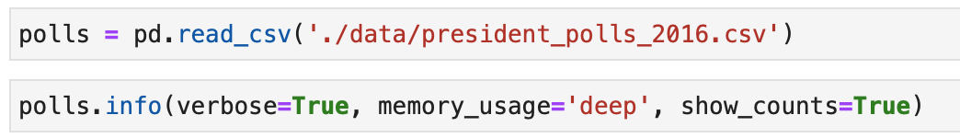
Partial Results for the info() Method - The Polls Data

Slide 18
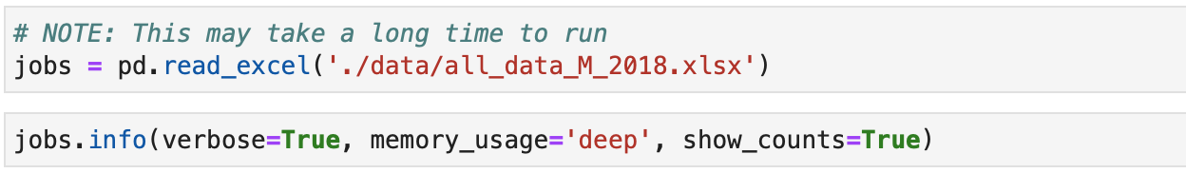
Partial Results for the info() Method – The Jobs Data

Slide 19
The nunique() and unique() methods
Method | Description
nunique(dropna=False) | Returns the number of unique values in each column.
unique() | Returns the unique values in each column.
.nunique() naturally produces one number per column, while .unique() may produce arrays of different lengths for different columns.
Hence, .unique() is used for a single Series, while .nunique() can be used for the whole DataFrame

Slide 20
Partial results for the nunique() method – the Polls data

Slide 21
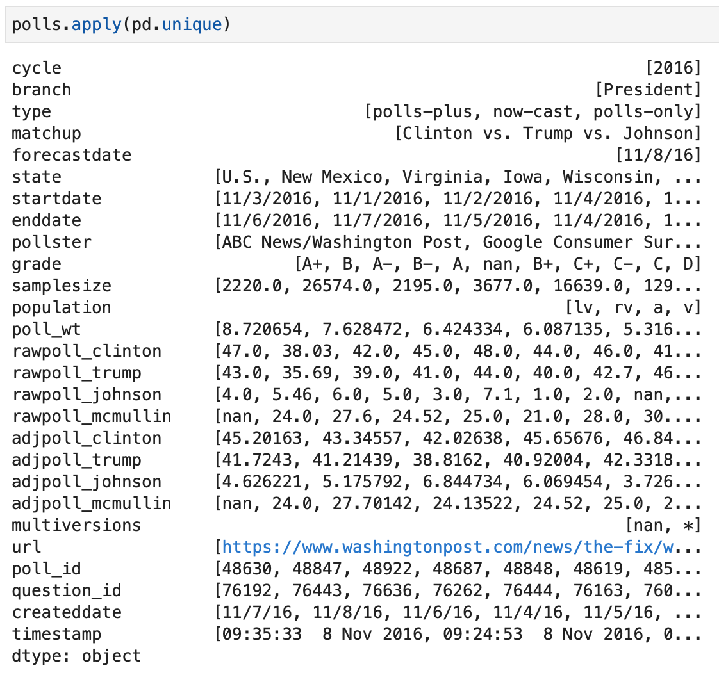
Partial results for the unique() method – the Polls data

Slide 22
The value_counts() Method
Method | Description
value_counts(params) | Returns the count for each of the unique values in a series.
Parameter | Description
normalize | If True, returns the counts as a percent of the total rather than the actual counts.
dropna | If True (the default), it ignores null values. Can only be used with Series objects.

Slide 23
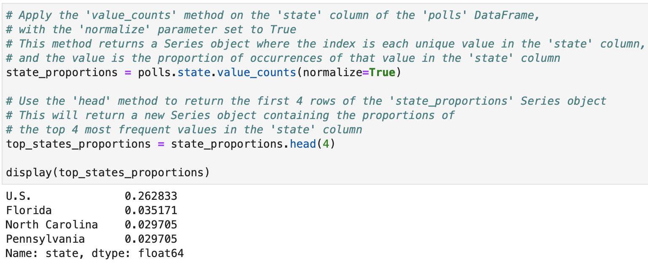
How to use value_counts() with the normalize Parameter

Slide 24
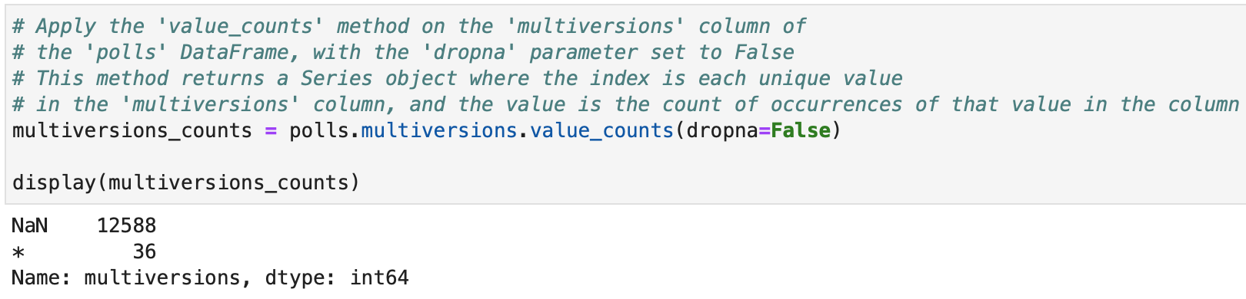
How to use value_counts( ) with the dropna Parameter

Slide 25
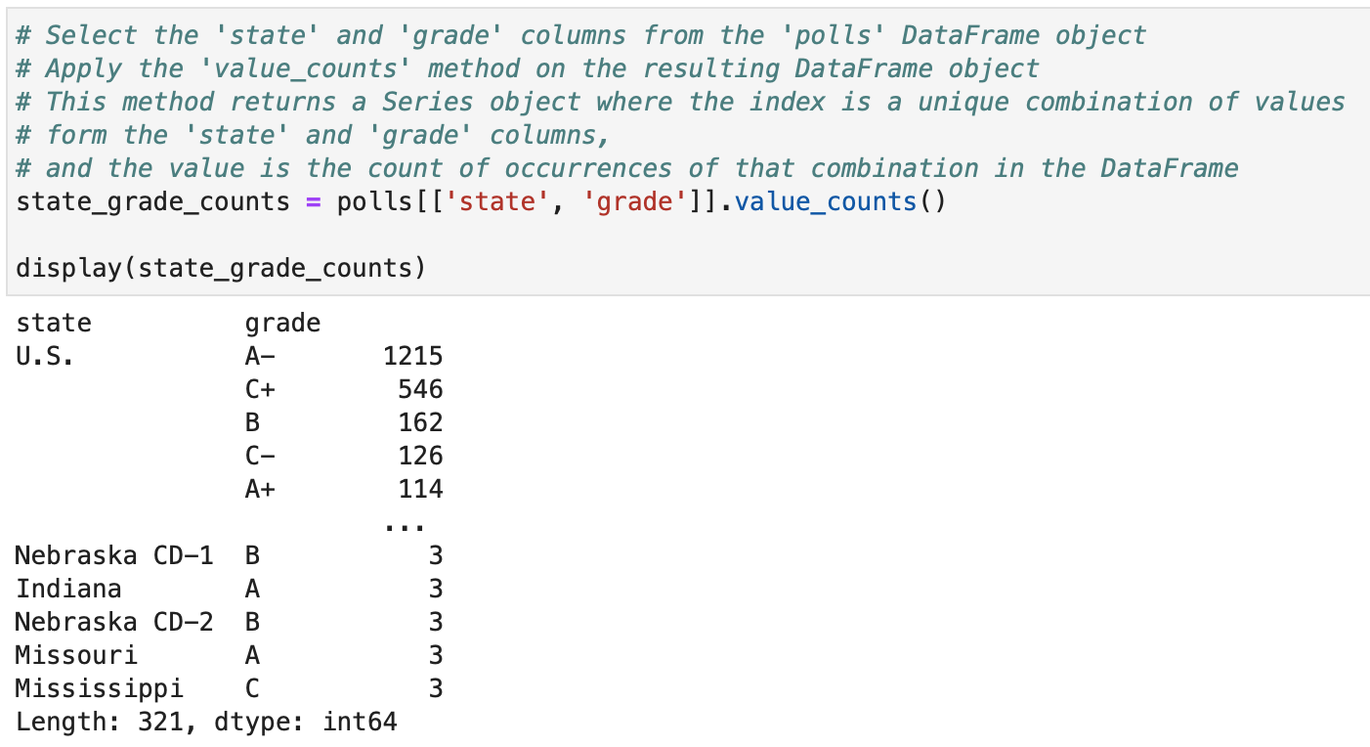
How to use value_counts( ) with Multiple Columns

Slide 26

Can you achieve the same results without using value_counts() ?
Ask ChatGPT ☺

Slide 27
How to Simplify the Data

Slide 28
The drop( ) Method
Method | Description
drop(params) | Drops the columns that are specified by the columns parameter.
Parameter | Description
columns | List of columns to be dropped.
errors | What to do if a specified column doesn’t exist: ‘ignore’ (the default) or ‘raise’.
inplace | True makes the changes directly to the DataFrame.

Slide 29
Identifying the columns to drop using using nunique()

Slide 30
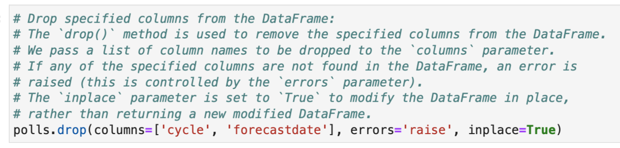
Dropping Columns

Slide 31
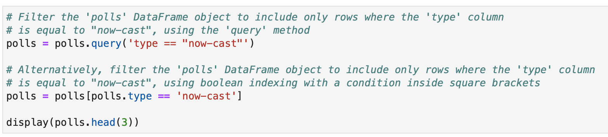
Dropping Rows based on Conditions

Slide 32
Dropping Duplicate Rows
When data comes from several sources, duplicate rows are possible.
In that case, we should remove all but one row from each set of duplicates.
To do that, you can use the duplicated() method to find the duplicate rows and the drop_duplicates() method to drop the duplicates.

Slide 33
The duplicated( ) Method
Method | Description
duplicated(params) | Identifies duplicated rows.
Parameter | Description
subset | List of columns to be used for identifying duplicates; otherwise, all columns are used.
keep | If ‘first’ (the default), all duplicates are marked as True except for the first occurrence in each set. If ‘last’, all duplicates are marked as True except for the last occurrence. If False, all duplicates are marked as True.

Slide 34
The drop_duplicates( ) Method
Method | Description
drop_duplicates(params) | Returns the DataFrame with duplicate rows removed.
Parameter | Description
subset | Same as for the duplicated() method.
keep | Same as for the duplicated() method except that the duplicate rows are dropped, not marked.
inplace | True makes the changes directly to the DataFrame; False (the default) returns a copy of the DataFrame with the duplicates dropped.

Slide 35
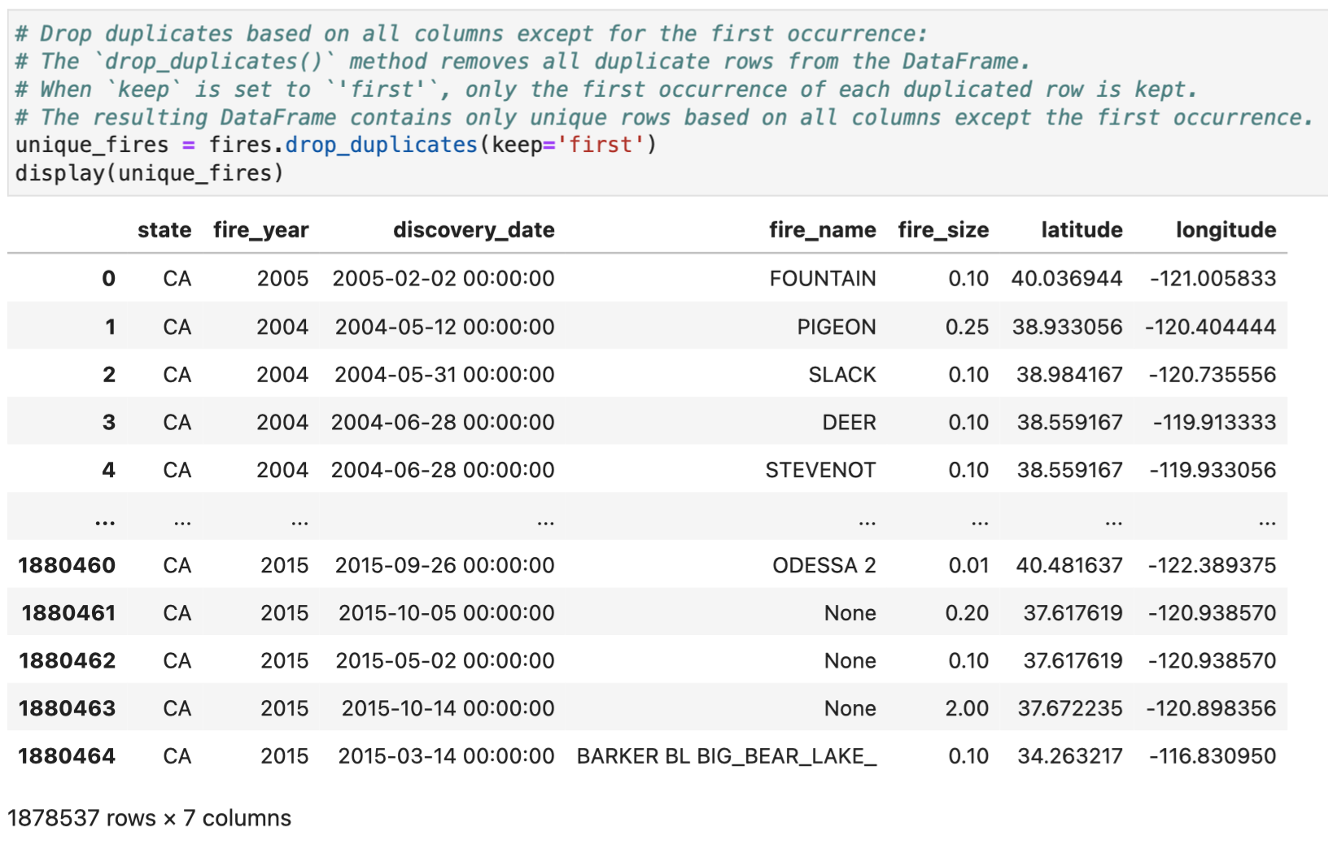
Dropping Duplicate Rows (Cont.)

Slide 36
What will happen if you run the following line?
Ask ChatGPT ☺

Slide 37
The rename( ) Method
Method | Description
rename(params) | Renames the columns of a DataFrame.
Parameter | Description
columns | A dictionary that contains the columns to be renamed and the new names for those columns.
inplace | Whether to make changes directly to the DataFrame. The default is False.

Slide 38
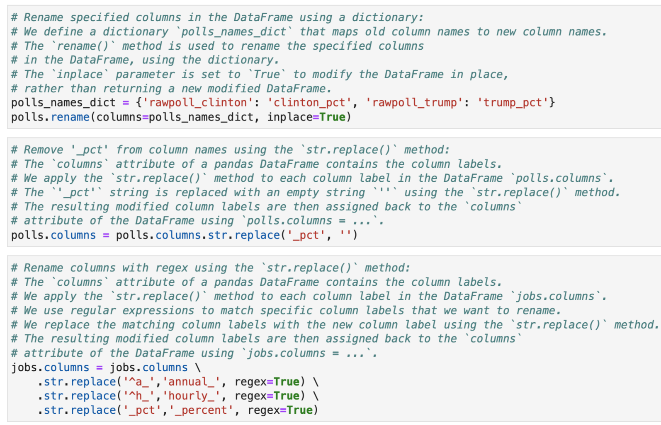
Renaming Columns

Slide 39
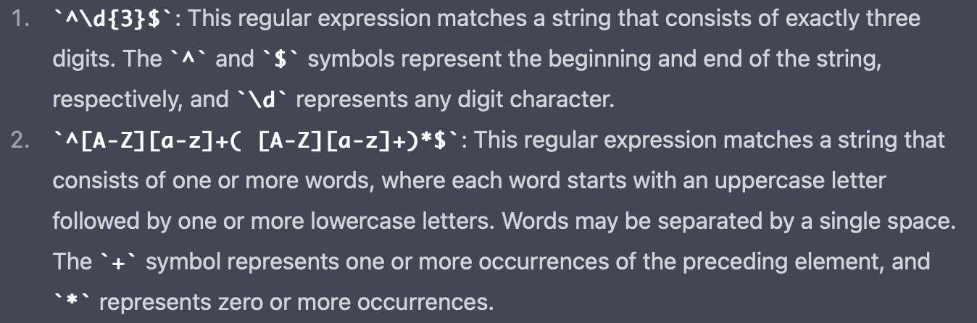
Python Time ☺ Regular Expressions
https://www.w3schools.com/python/python_regex.asp

Slide 40
How to Find and Fix Missing Values

Slide 41
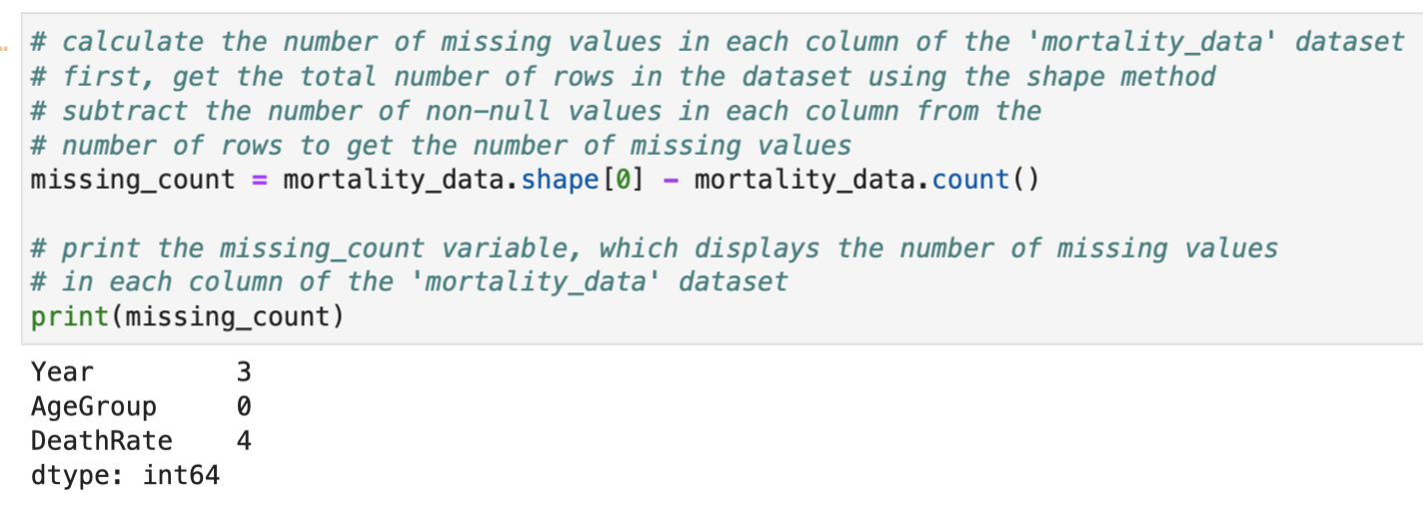
Finding the Number of Missing Values for each Column

Slide 42
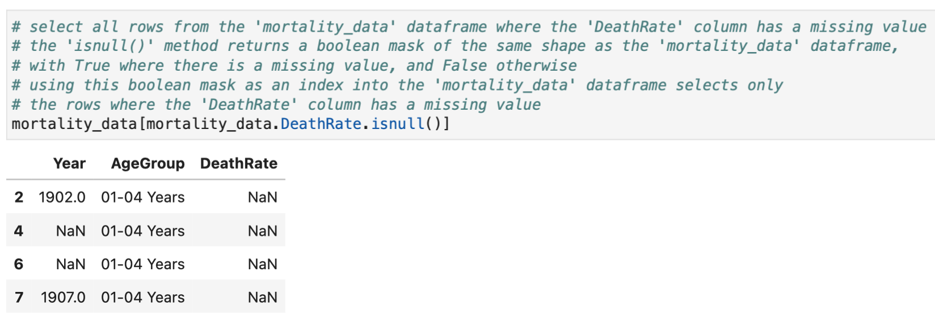
Finding Rows with Missing Values - a Specific Column

Slide 43
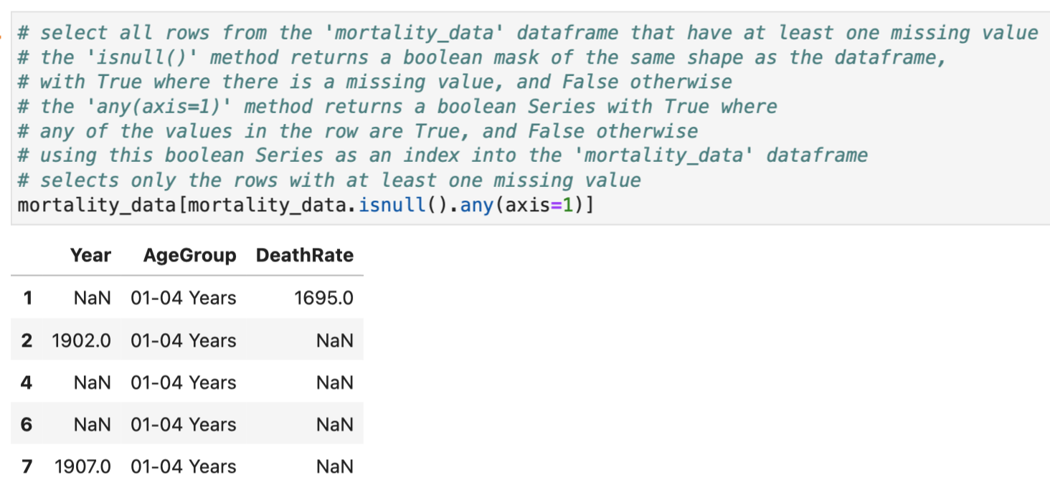
Finding Rows with Missing Values – Any Column

Slide 44
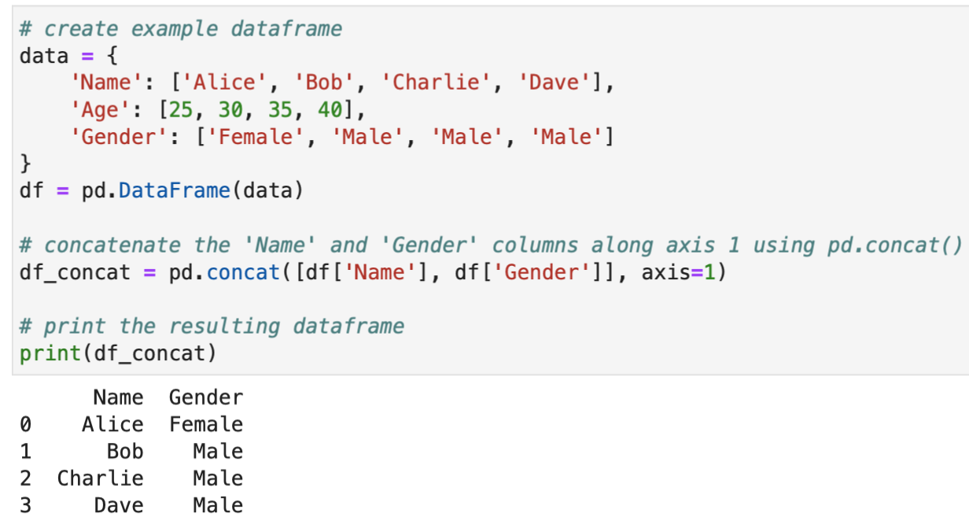
Python Time ☺ Using axis in DataFrame Operations

Slide 45
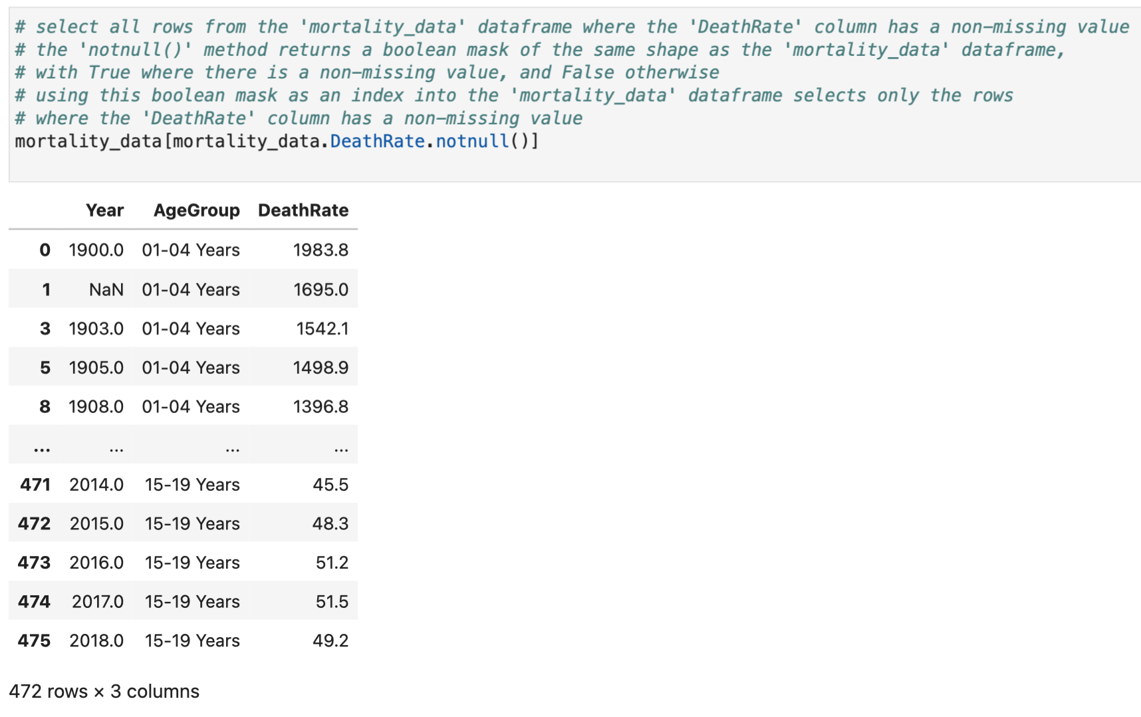
Finding Rows with No Missing Values for a Specific Column

Slide 46
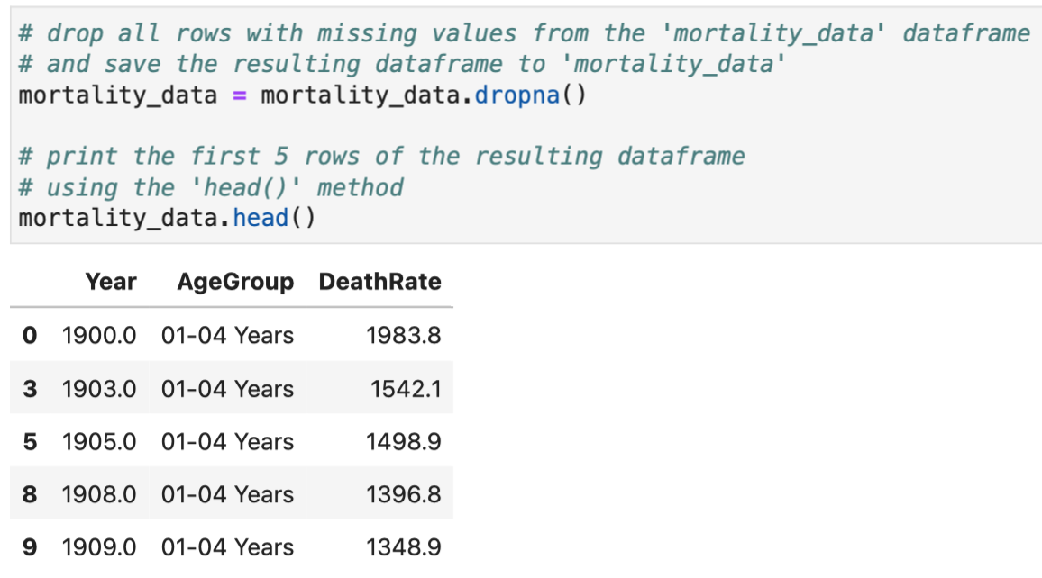
Dropping Rows with Missing Values in any Column

Slide 47
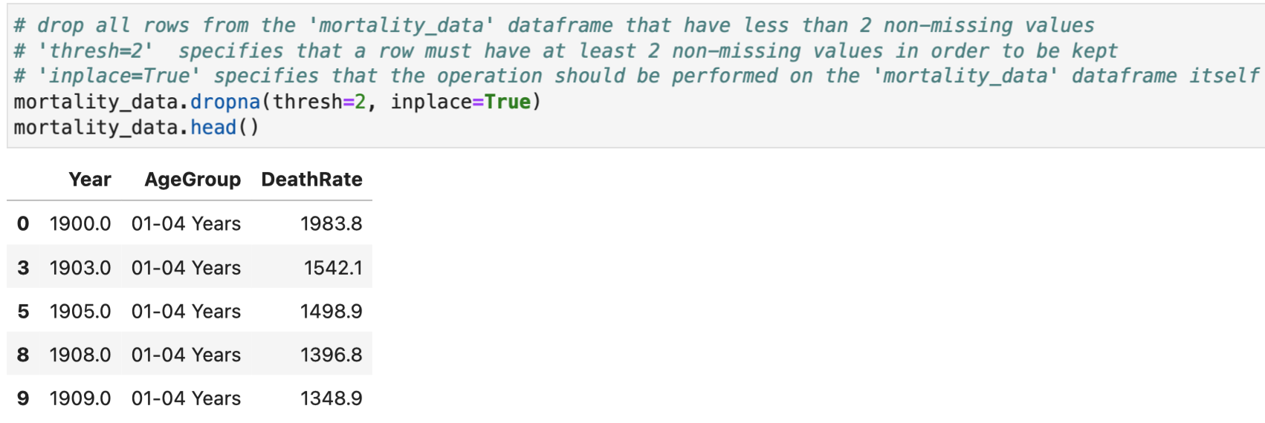
Dropping Rows with Missing Values for a Threshold

Slide 48
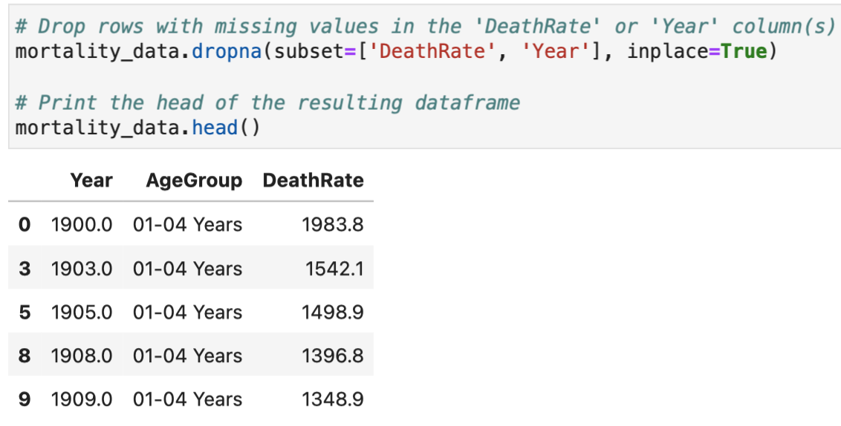
Dropping Rows with Missing Values for a Subset of the Columns

Slide 49
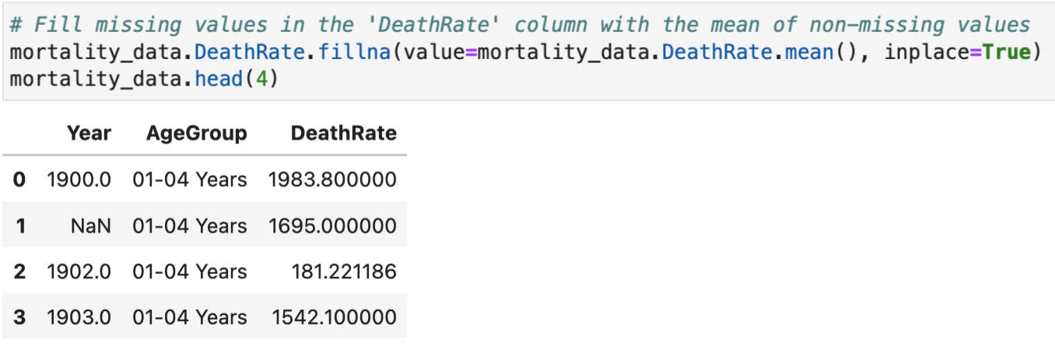
Fill Missing Values in a DataFrame using filna() – The ‘mean’ method

Slide 50
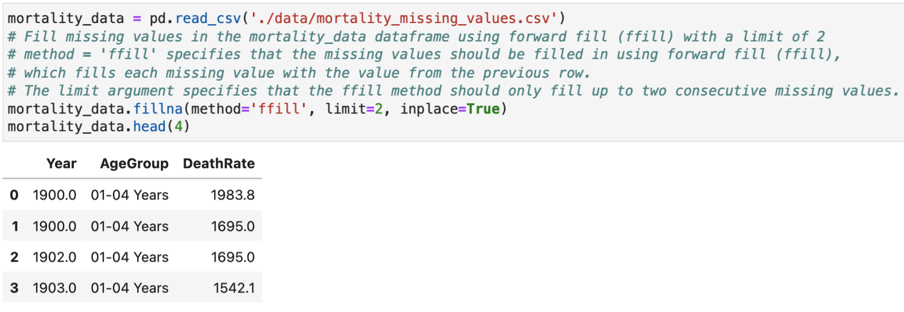
Fill Missing Values in a DataFrame using filna() – The ‘forward filling’ method

Slide 51
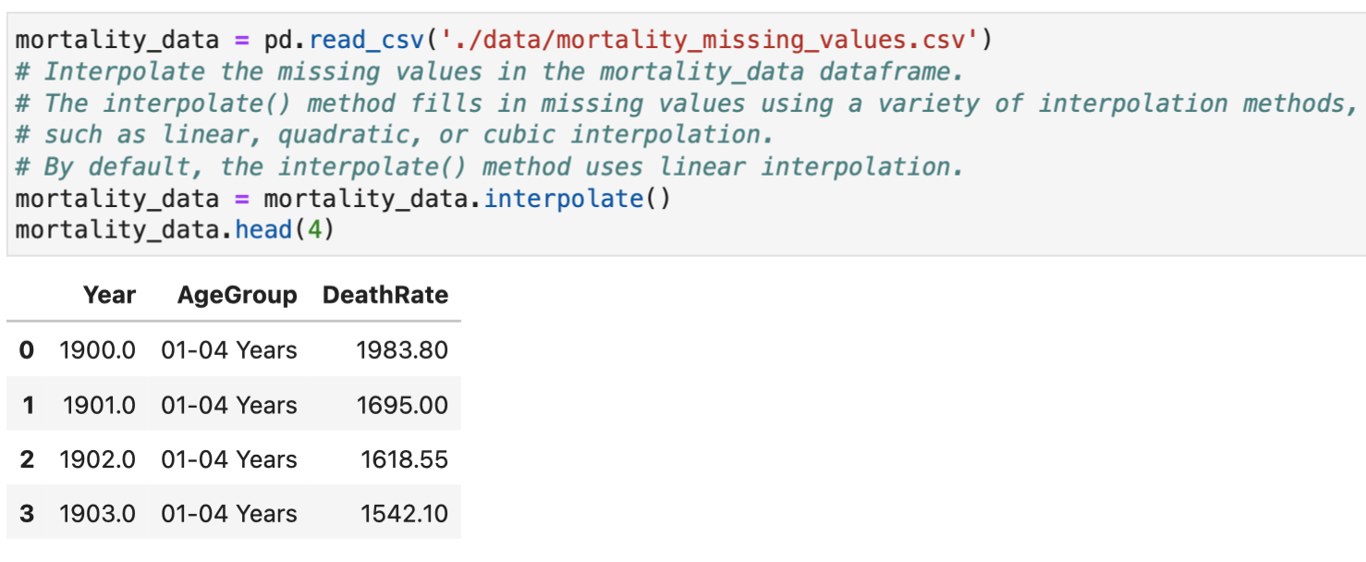
Fill Missing Values in a DataFrame using interpolate()

Slide 52
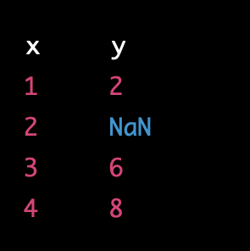
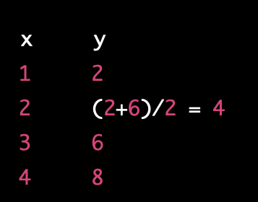
Interpolation
Interpolation is a method used to estimate values for data points that are missing or have not been observed.
Often used when missing values are present in a time series or other continuous data set.
Linear Interpolation

Slide 53
How to Fix Data Type Problems

Slide 54
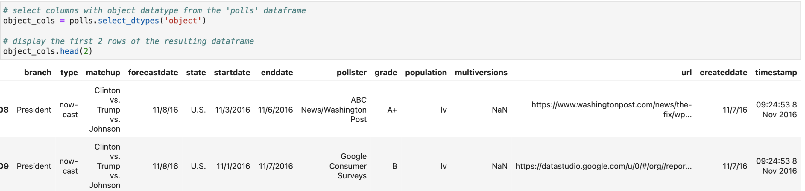
Finding Date and Number Columns that are Imported as Objects

Slide 55
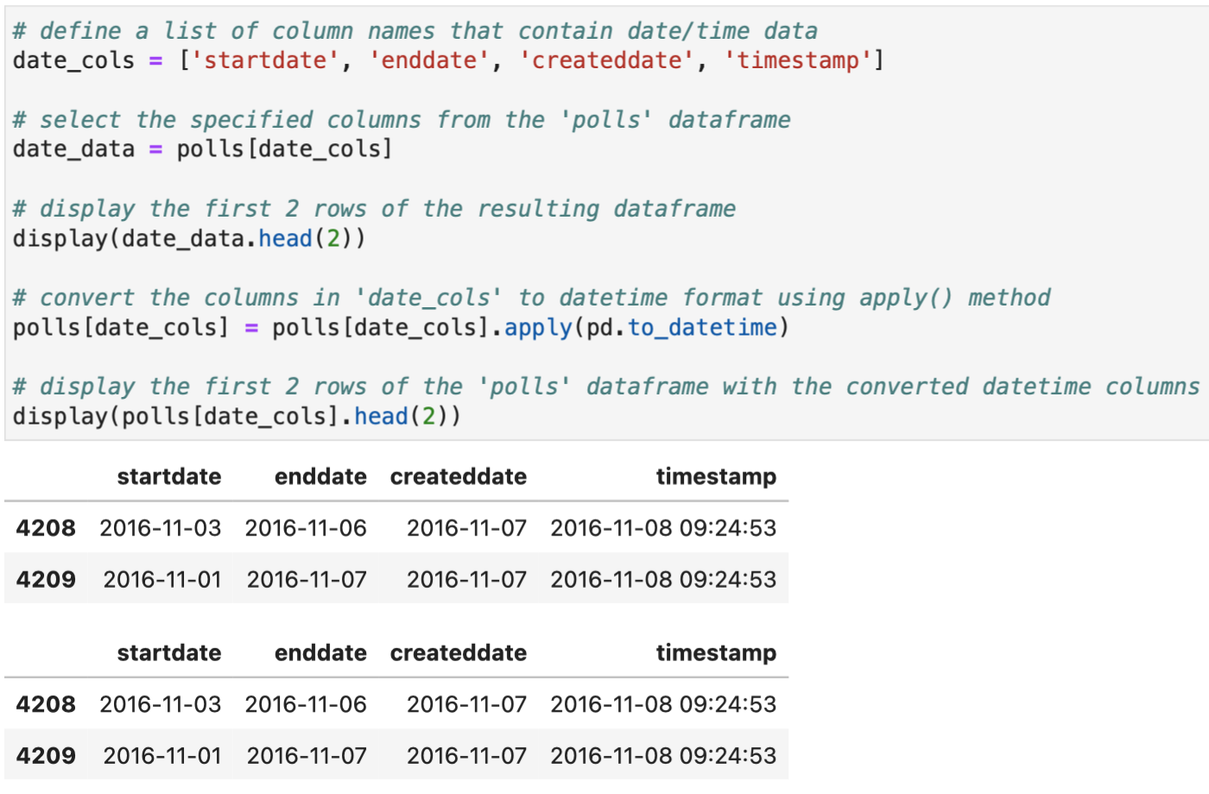
Converting date and time strings to datetime

Slide 56
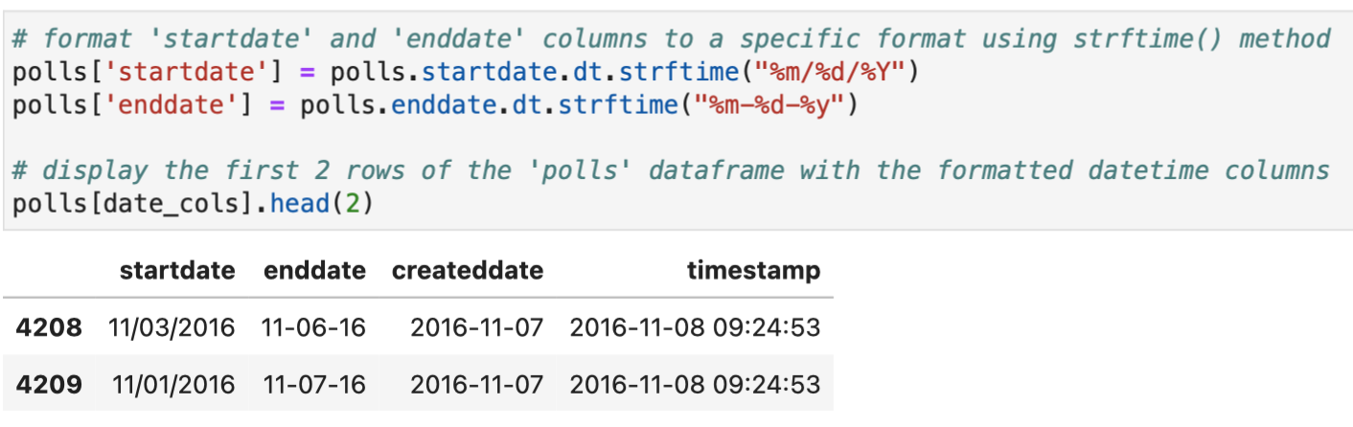
Formatting the datetime Columns

Slide 57
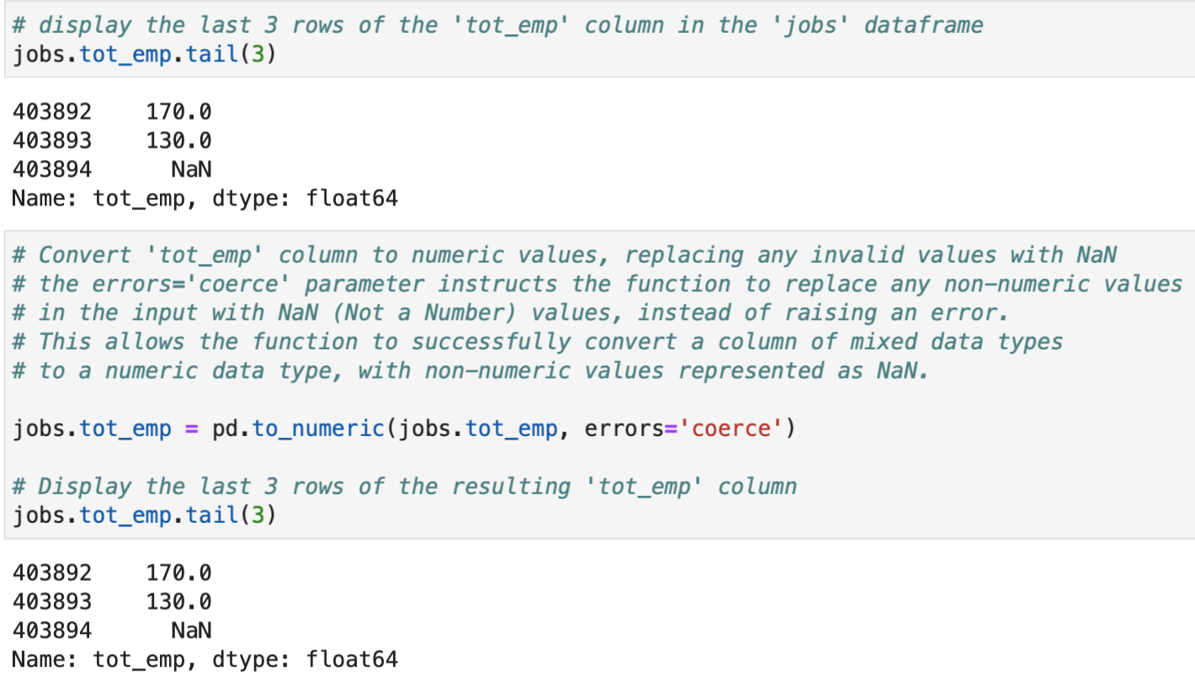
Converting Object Columns to Numeric

Slide 58
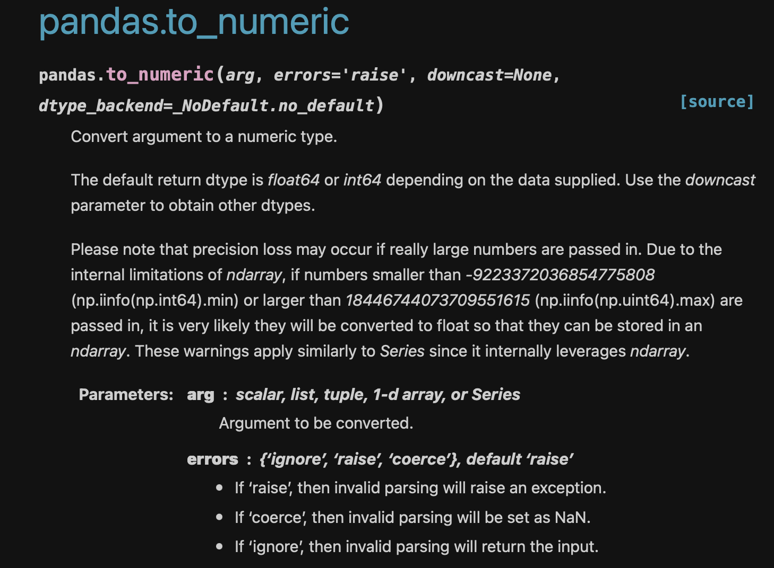
Python Time ☺ pandas_to_numeric

Slide 59
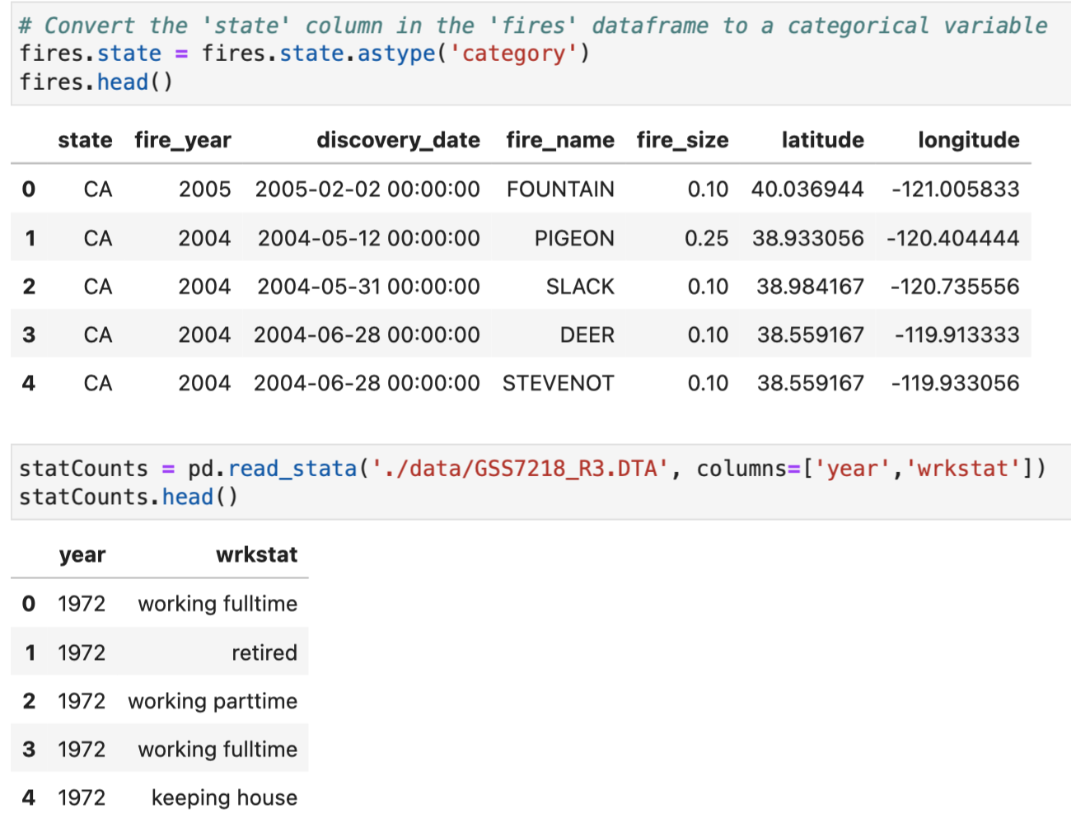
Working with Category Data

Slide 60
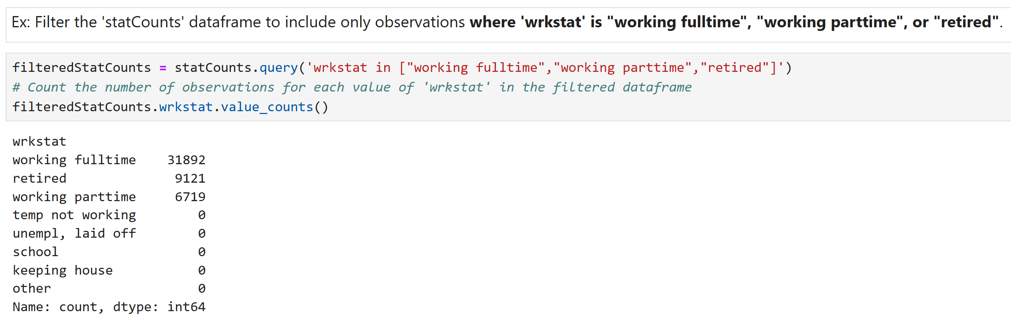
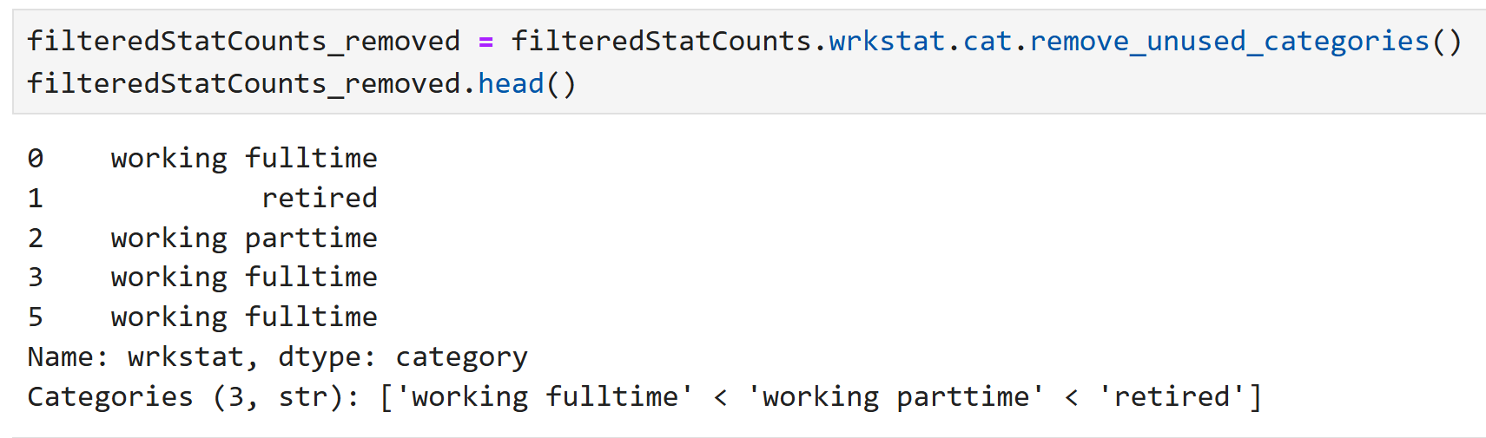
Working with Category Data (Cont.)

Slide 61
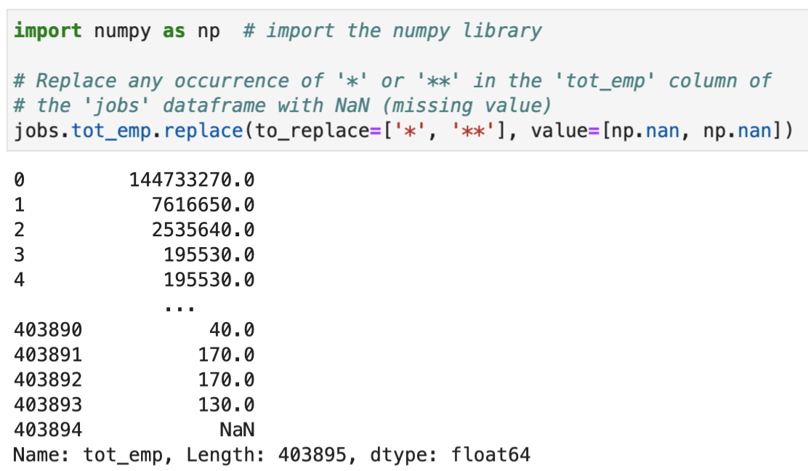
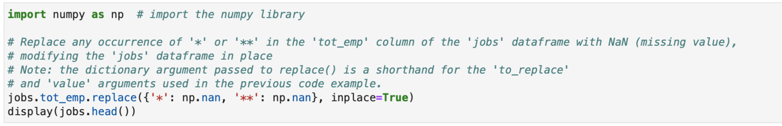
Replacing Invalid Values

Slide 62
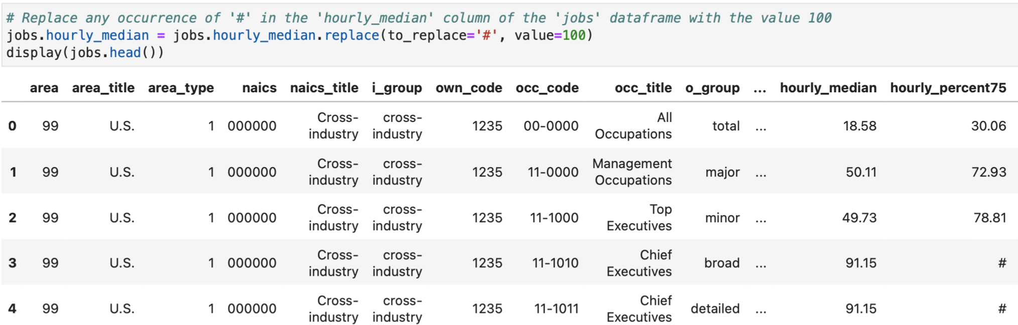
Replacing Invalid Values (Cont.)

Slide 63
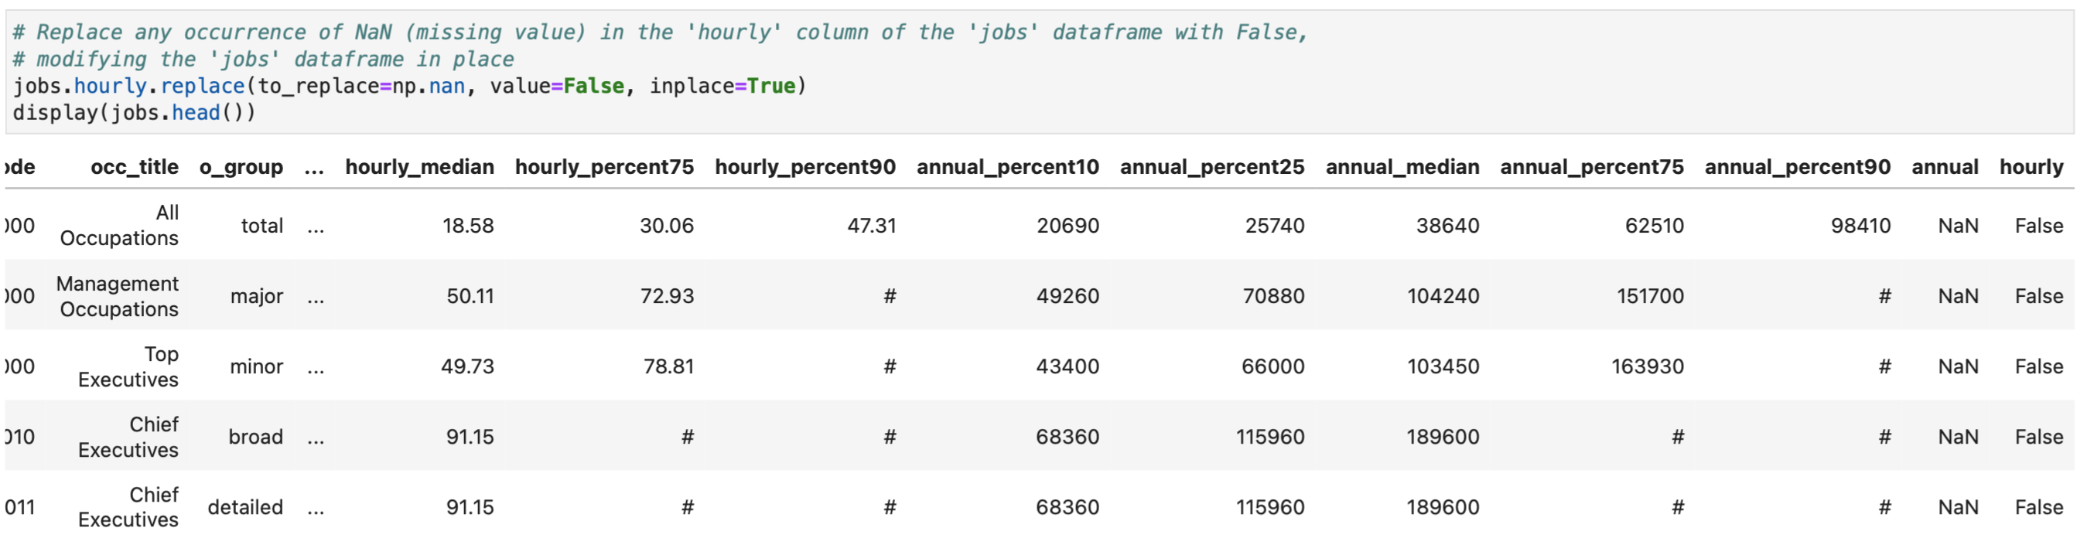
Replacing Invalid Values (Cont.)

Slide 64
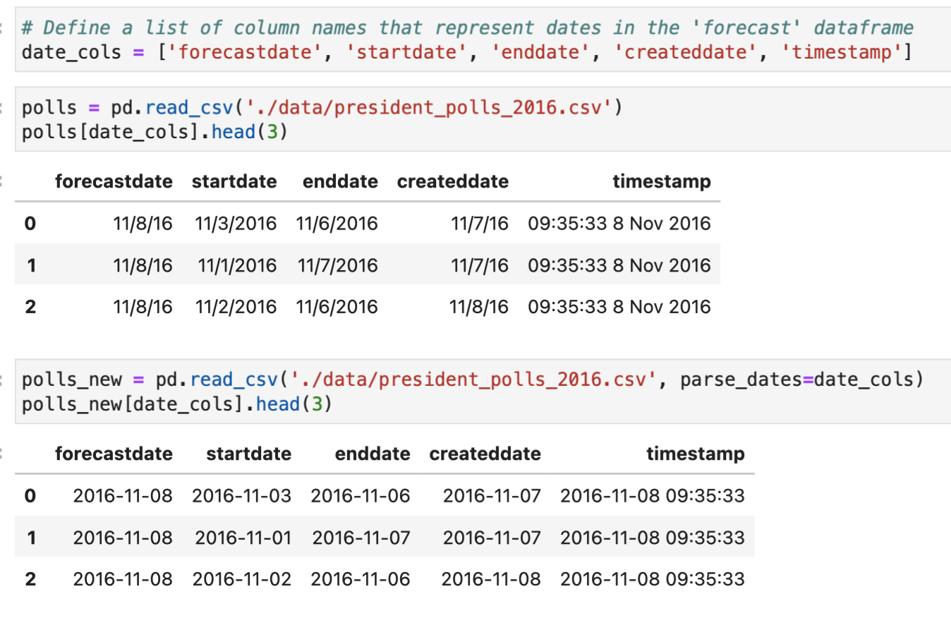
Fixing Data Type Problems when Importing the Data

Slide 65
How to Find and Fix Outliers

Slide 66
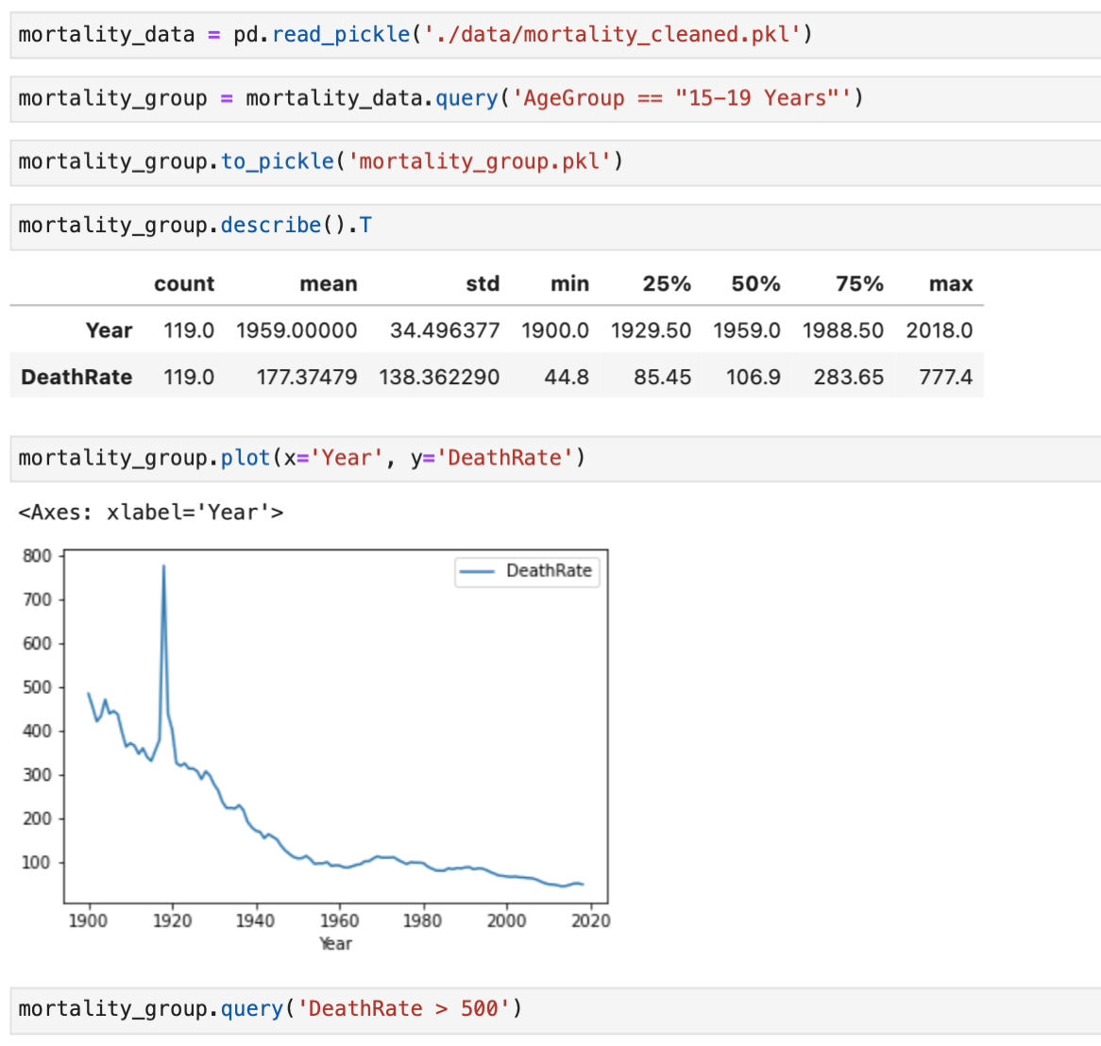
Finding Outliers

Slide 67
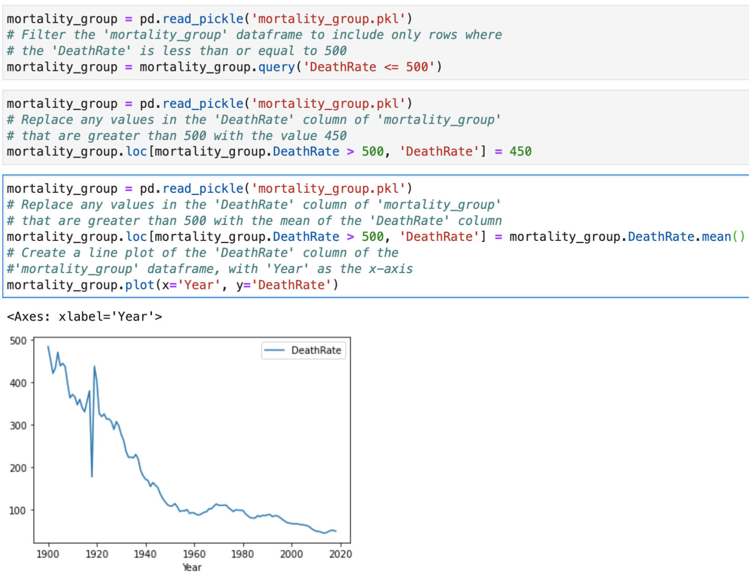
Fixing Outliers

Slide 68
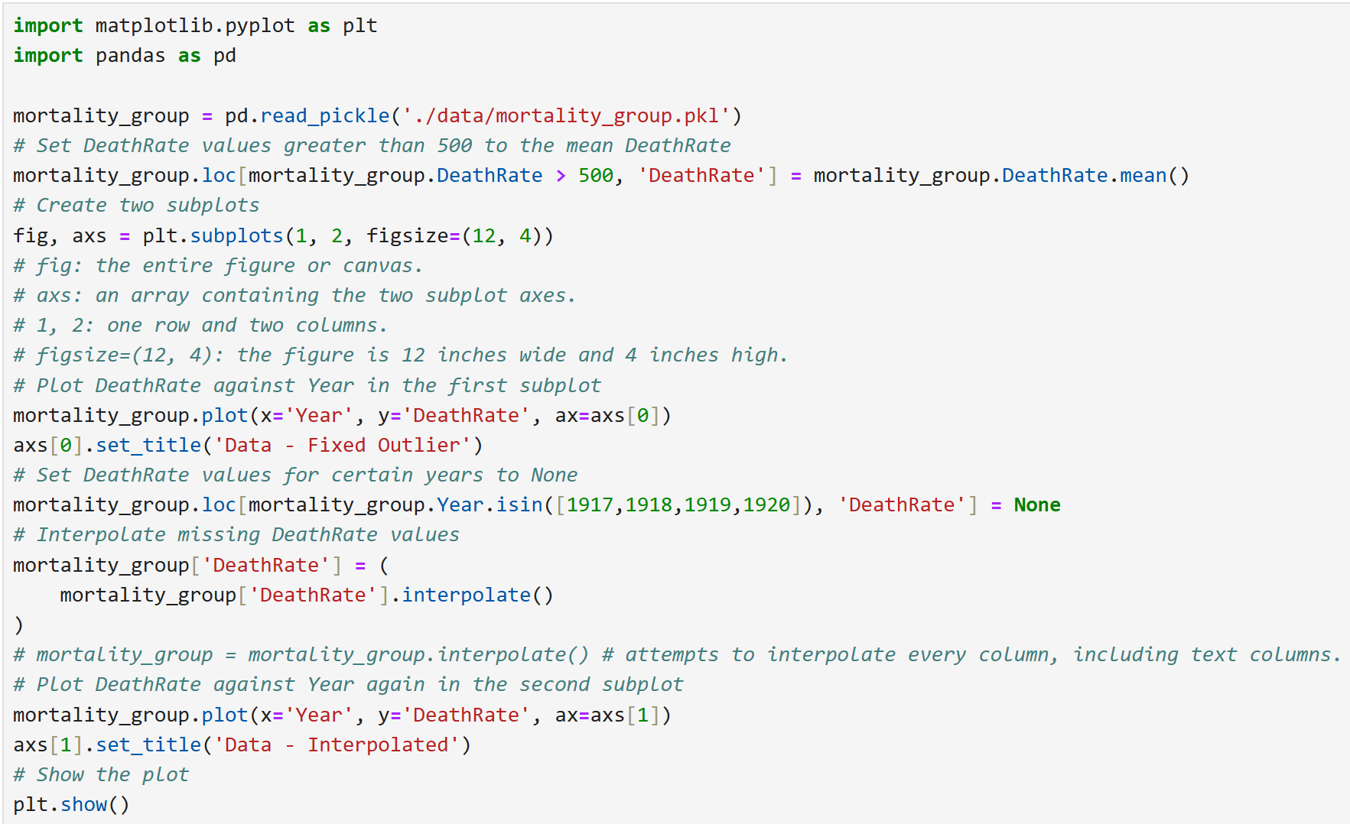
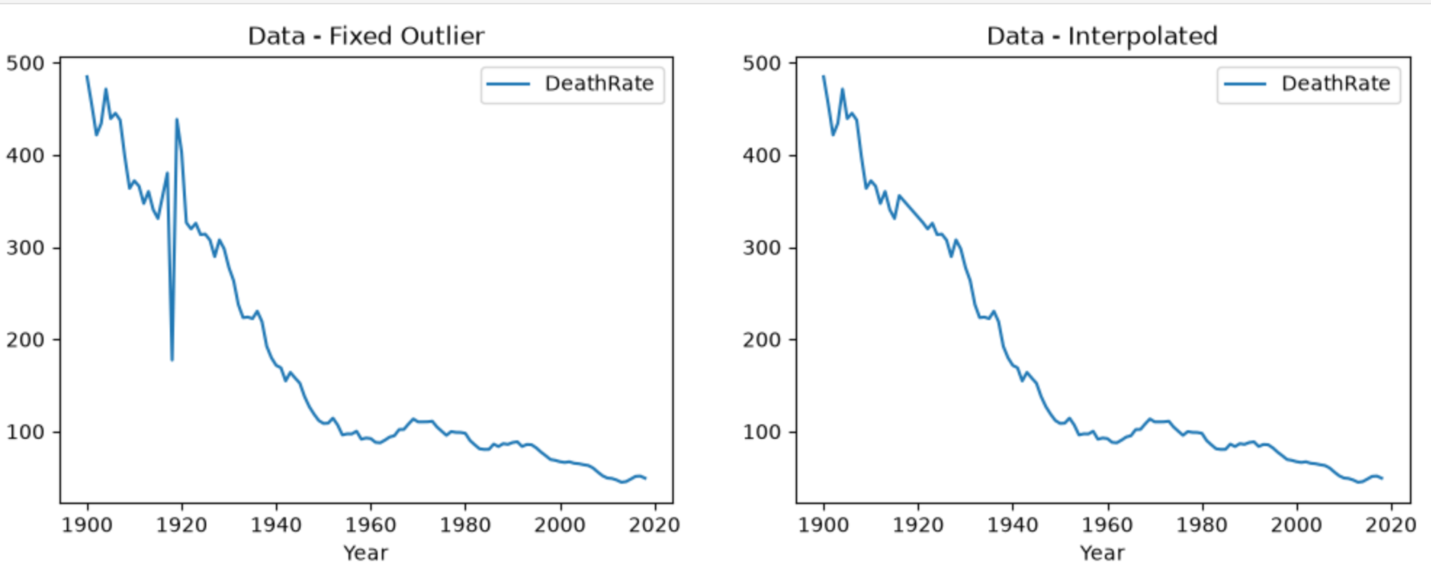
Fixing Outliers (Cont.)

Slide 69
Annotate the Plots to Highlight the Changes

Slide 70
References
Data science from scratch: first principles with Python, Joel Grus, O'Reilly Media, 2019
Python for Data Analysis: Data Wrangling with Pandas, NumPy, and IPython, Wes McKinney, O'Reilly Media, 3rd edition, 2022.
Python Data Science Handbook: Essential Tools for Working with Data, Jake Vanderplas, O'Reilly Media, 2022
Murach’s Python for Data Analysis, Scott McCoy, Mike Murach & Associates, Incorporated, 2021.
Intro to Python for Computer Science and Data Science: Learning to Program with AI, Big Data and The Cloud, Paul Deitel, Pearson Education Limited, 2021.
ChatGPT

Slide 71

End of lecture …

